Slide 1
Selected topics 1
Python
Dr: Nashwa Nageh

Slide 2
Agenda
Graphical User Interfaces
Using the tkinter Module
Displaying Text with Label Widgets
Organizing Widgets with Frames
Button Widgets and Info Dialog Boxes
Getting Input with the Entry Widget
Using Labels as Output Fields

Slide 3
Graphical User Interfaces (1 of 3)
A computer’s user interface is the part of the computer with which the user interacts. One part of the user interface consists of hardware devices, such as the keyboard and the video display. Another part of the user interface lies in the way that the computer’s operating system accepts commands from the user.
For many years, the only way that the user could interact with an operating system was through a command line interface.
In the 1980s, a new type of interface known as a graphical user interface came into use in commercial operating systems, called the graphical user interface
User Interface: the part of the computer with which the user interacts
Command line interface: it displays a prompt, and the user types a command that is then executed
Graphical User Interface (GUI): allows users to interact with a program through graphical elements on the screen.

Slide 4
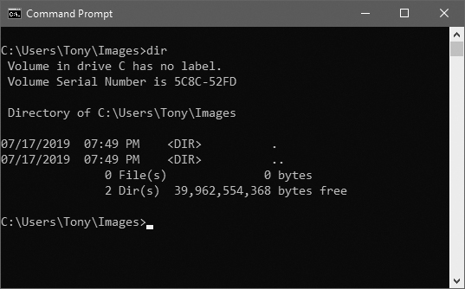
Graphical User Interfaces (2 of 3)
Command line interface: displays a prompt and the user types a command that is then executed
Figure 1 A command line interface

Slide 5
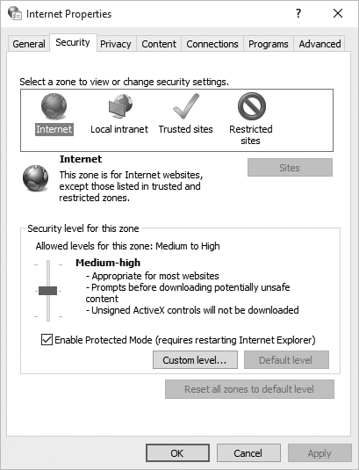
Graphical User Interfaces (3 of 3)
Graphical User Interface (GUI): (GUI; pronounced “gooey”), allows the user to interact with the operating system and other programs through graphical elements on the screen.
GUIs also popularized the use of the mouse as an input device.
GUIs allow the user to point at graphical elements and click the mouse button to activate them.
Much of the interaction with a GUI is done through dialog boxes, which are small windows that display information and allow the user to perform actions.
Responsible for most of the interaction through GUI
User interacts with graphical elements such as icons, buttons, and slider bars

Slide 6
GUI Programs Are Event-Driven
In text-based environments, programs determine the order in which things happen
The user can only enter data in the order requested by the program
GUI environment is event-driven
The user determines the order in which things happen
User causes events to take place and the program responds to the events

Slide 7
Using the tkinter Module
Python does not have GUI programming features built into the language itself. However, it comes with a module named tkinter that allows you to create simple GUI programs.
The name “tkinter” is short for “Tk interface.”
tkinter module allows you to create simple GUI programs
A GUI program presents a window with various graphical widgets with which the user can interact or view. The tkinter module provides 15 widgets, which are described in Table 1.
We won’t cover all of the tkinter widgets in this chapter, but we will demonstrate how to create simple GUI programs that gather input and display data
Widget: A graphical element that the user can interact with or view (Known also as control)
Presented by a GUI program

Slide 8
Using the tkinter Module
Table 1 tkinter widgets
Widget | Description
Button | A button that can cause an action to occur when it is clicked.
Canvas | A rectangular area that can be used to display graphics.
Checkbutton | A button that may be in either the “on” or “off” position.
Entry | An area in which the user may type a single line of input from the keyboard.
Frame | A container that can hold other widgets.
Label | An area that displays one line of text or an image.
Listbox | A list from which the user may select an item
Menu | A list of menu choices displayed when the user clicks a Menubutton widget.
Menubutton | A menu that is displayed on the screen and may be clicked by the user
Message | Displays multiple lines of text.
Radiobutton | A widget that can be either selected or deselected. Radiobutton widgets usually appear in groups and allow the user to select one of several options.
Scale | A widget that allows the user to select a value by moving a slider along a track.
Scrollbar | Can be used with some other types of widgets to provide scrolling ability.
Text | A widget that allows the user to enter multiple lines of text input.
Toplevel | A container, like a Frame, but displayed in its own window.

Slide 9
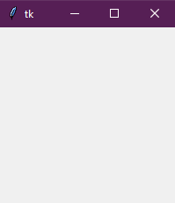
Using the tkinter Module
The simplest GUI program that we can demonstrate is one that displays an empty window. The below program shows how we can do this using the tkinter module. When the program runs, the window shown in the figure is displayed. To exit the program, simply click the standard Windows close button (×) in the upper right corner of the window.
# This program displays an empty window.
import tkinter
def main():
# Create the main window widget.
main_window = Tk()
# Enter the tkinter main loop.
tkinter.mainloop()
# Call the main function.
main()
main_window = Tk() creates an instance of the tkinter module’s Tk class and assigns it to the main_window variable. This object is the root widget, which is the main window in the program.
tkinter.mainloop() calls the tkinter module’s mainloop function. This function runs like an indefinite loop until you close the main window.

Slide 10
import <module> vs. from <module> import *
In general, we use from <module>import * when we want to save ourselves from typing the module name repeatedly.
In other words, use from <module> import when referring to a member of the module many times in the code.
Example: in order to avoid writing tkinter. before each command, you can use from tkinter import * instead of import tkinter at the beginning of your program.
OR
import tkinter
tkinter.mainloop()
from tkinter import *
mainloop()

Slide 11
Using the tkinter Module
Programs that use tkinter do not always run reliably under IDLE
For best results run them from operating system command prompt
Most programmers take an object-oriented approach when writing GUI programs.
__init__ method builds the GUI
When an instance is created the GUI appears on the screen

Slide 12
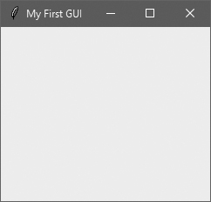
Example 1
# This program displays a window with a title.
from tkinter import *
class MyGUI:
def __init__(self):
# Create the main window widget.
self.main_window = Tk()
# Display a title.
self.main_window.title('My First GUI')
# Enter the tkinter main loop.
mainloop()
# Create an instance of the MyGUI class.
my_gui = MyGUI()

Slide 13
Display Text with Label Widgets
Label widget: displays a single line of text in a window
Made by creating an instance of tkinter module’s Label class
Format: Label(self.main_window,text='my text')
First argument references the root widget, second argument shows text that should appear in label
pack method: determines where a widget should be positioned and makes it visible when the main window is displayed
Called for each widget in a window
Receives an argument to specify positioning
Positioning depends on the order in which widgets were added to the main window
Valid arguments: side='top', side='left’, side='right’, side=‘bottom’(or TOP (default), BOTTOM, LEFT, RIGHT)

Slide 14
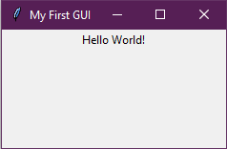
Example 2
# This program displays a title and a label with text.
from tkinter import *
class MyGUI:
def __init__(self):
# Create the main window widget.
self.main_window = Tk()
# Display a title.
self.main_window.title('My First GUI')
# Create a Label widget containing the text 'Hello World!'
self.label = Label(self.main_window, text='Hello World!')
# Call the Label widget's pack method.
self.label.pack()
# Enter the tkinter main loop.
mainloop()
# Create an instance of the MyGUI class.
my_gui = MyGUI()
The pack method determines where a widget should be positioned and makes the widget visible when the main window is displayed. (You call the pack method for each widget in a window.)

Slide 15
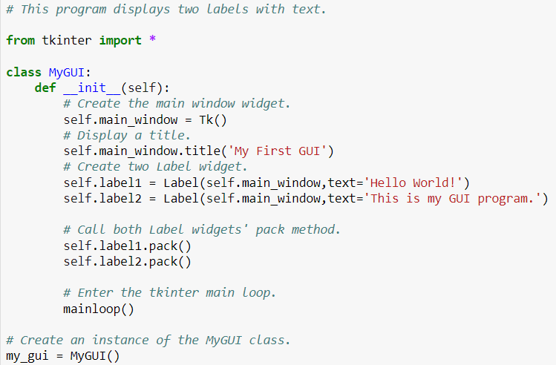

Example 3
Notice the two Label widgets are displayed with one stacked on top of the other. We can change this layout by specifying an argument to pack method

Slide 16
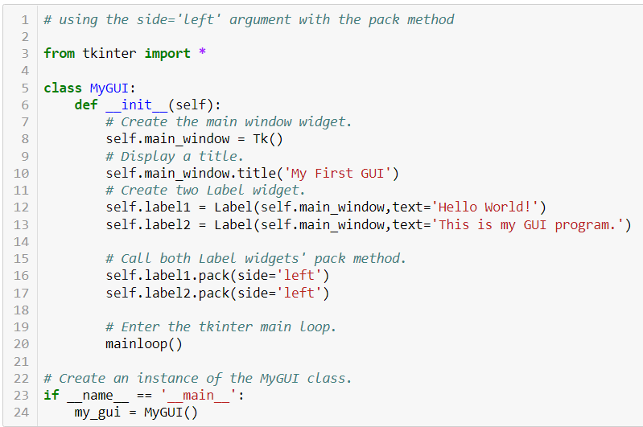

Example 4
In lines16 and 17, label1 widget was added to the main window first, it will appear at the leftmost edge. The label2 widget was added next, so it appears next to the label1 widget.
As a result, the labels appear side by side.

Slide 17


Adding Borders to Labels
When creating a Label widget, you can use the borderwidth and relief arguments to display a border around the label
The borderwidth argument specifies the width of the border, in pixels
The relief argument specifies the border style
self.label = Label(self.main_window,
text='Hello World',
borderwidth=1,
relief='solid’)
self.label = Label(self.main_window,text='Hello World',
borderwidth=4,
relief='solid’)

Slide 18

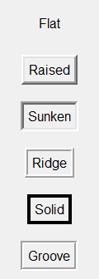





Values for relief Argument
relief Argument | Description
relief='flat' | The border is hidden and there is no 3D effect.
relief='raised' | The widget has a raised 3D appearance.
relief='sunken' | The widget has a sunken 3D appearance.
relief='ridge' | The border around the widget has a raised 3D appearance.
relief='solid' | The border appears as a solid line with no 3D effect.
relief='groove' | The border around the widget appears as a groove.

Slide 19
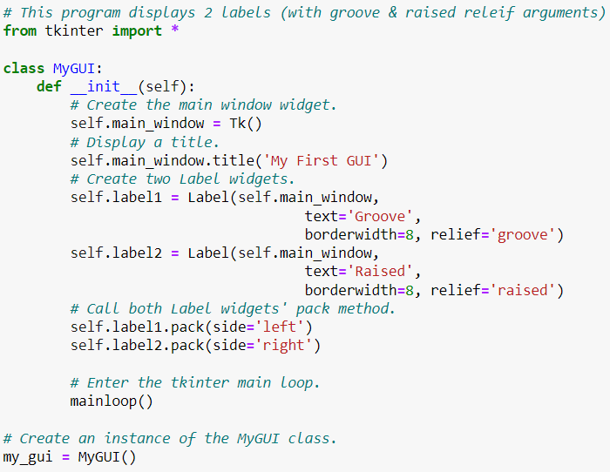
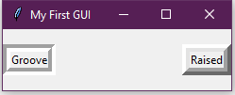
Example 5

Slide 20
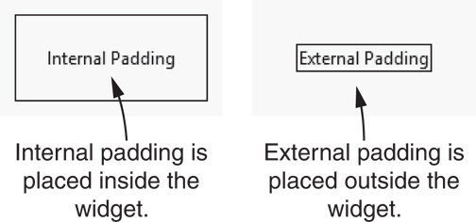
Padding
Padding: space that appears around a widget
Internal padding appears around the inside edge of a widget
External padding appears around the outside edge of a widget

Slide 21
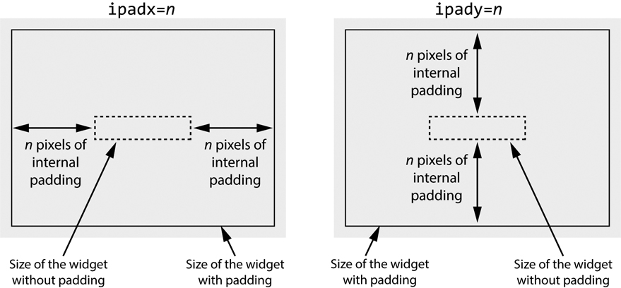
Internal Padding
To add horizontal internal padding to a widget, pass the argument ipadx=n to the widget's pack method
To add vertical internal padding to a widget, pass the argument ipady=n to the widget's pack method

Slide 22
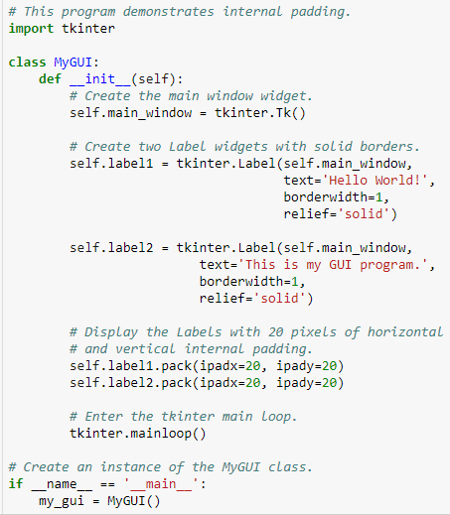
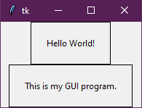
Internal Padding- Example
Notice that when used import tkinter at the beginning of the program we had to add tkinter. before each command

Slide 23
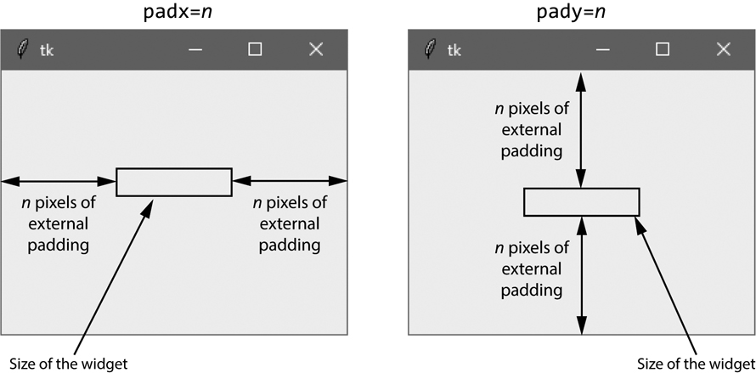
External Padding
To add horizontal external padding to a widget, pass the argument padx=n to the widget's pack method
To add vertical external padding to a widget, pass the argument pady=n to the widget's pack method

Slide 24
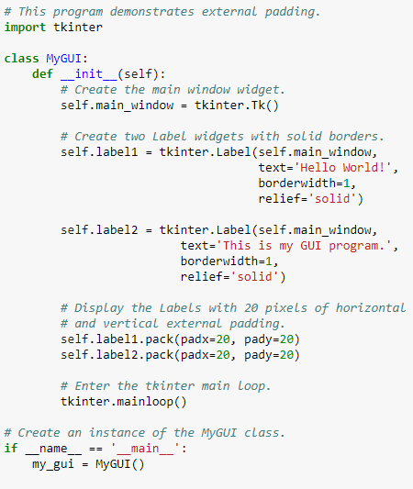
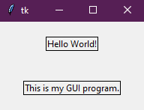
External Padding- Example

Slide 25
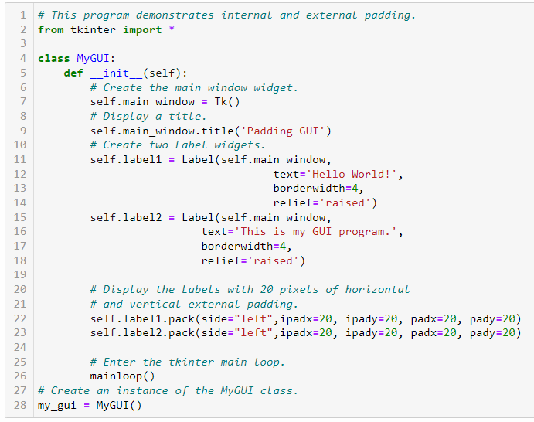
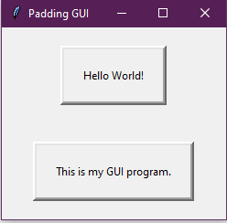
Internal and External Padding- Example

Slide 26
Organizing Widgets with Frames
Frame widget: A container that holds other widgets
Useful for organizing and arranging groups of widgets in a window.
For example, you can place a set of widgets in one Frame and arrange them in a particular way, then place a set of widgets in another Frame and arrange them in a different way.
Example:
Label(self.top_frame,text = 'hi')

Slide 27
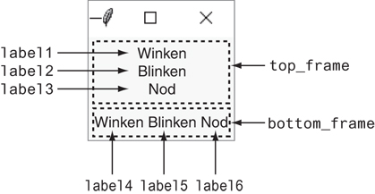
Organizing Widgets with Frames

Slide 28
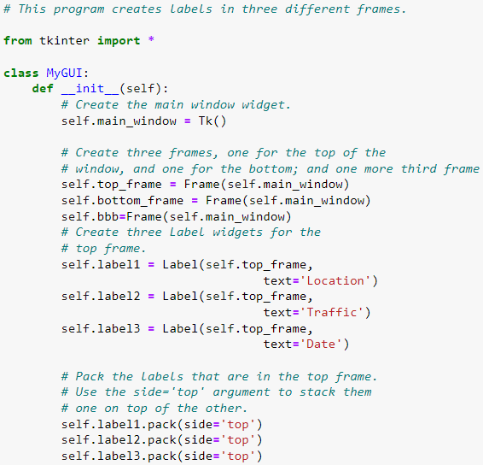
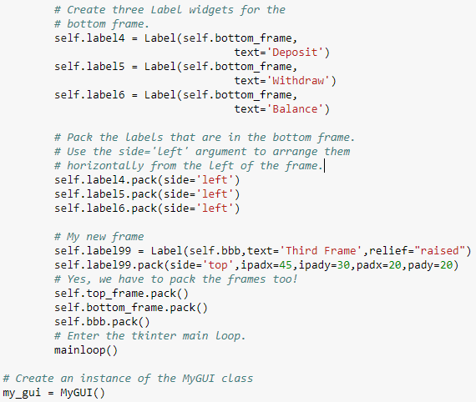
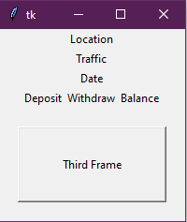

Slide 29
Editable code
# Create three Label widgets for the bottom frame.
self.label4 = Label(self.bottom_frame,
text='Deposit')
self.label5 = Label(self.bottom_frame,
text='Withdraw')
self.label6 = Label(self.bottom_frame,
text='Balance')
# Pack the labels that are in the bottom frame.
# Use the side='left' argument to arrange them
# horizontally from the left of the frame.
self.label4.pack(side='left')
self.label5.pack(side='left')
self.label6.pack(side='left')
# My new bbb frame
self.label99 = Label(self.bbb,text='Third Frame',relief="raised")
self.label99.pack(side='top',ipadx=45,ipady=30,padx=20,pady=20)
# Yes, we have to pack the frames too!
self.top_frame.pack()
self.bottom_frame.pack()
self.bbb.pack()
# Enter the tkinter main loop.
mainloop()
# Create an instance of the MyGUI class
my_gui = MyGUI()
# This program creates labels in three different frames.
from tkinter import *
class MyGUI:
def __init__(self):
# Create the main window widget.
self.main_window = Tk()
# Create two frames, one for the top of the
# window, and one for the bottom.
self.top_frame = Frame(self.main_window)
self.bottom_frame = Frame(self.main_window)
self.bbb=Frame(self.main_window)
# Create three Label widgets for the top frame.
self.label1 = Label(self.top_frame,
text='Location')
self.label2 = Label(self.top_frame,
text='Traffic')
self.label3 = Label(self.top_frame,
text='Date’)
self.label1.pack(side='top')
self.label2.pack(side='top')
self.label3.pack(side='top')

Slide 30
Button Widgets and Info Dialog Boxes
You use the Button widget to create a standard button in a window.
When the user clicks a button, a specified function or method is called.
An info dialog box is a simple window that displays a message to the user and has an OK button that dismisses the dialog box.
You can use the tkinter.messagebox module’s showinfo function to display an info dialog box.
Button widget: widget that the user can click to cause an action to take place
When creating a button can specify:
Text to appear on the face of the button
A callback function
Callback function: A function or method that executes when the user clicks the button
Also known as an event handler.

Slide 31
Button Widgets and Info Dialog Boxes
Syntax: w = Button ( root, option=value, ... )
Parameters:
root: represents the parent window.
options: below is the list of most used options for this widget. These options can be used as key-value pairs separated by commas.
option | Description
command | Function or method to be called when the button is clicked.
bg | Normal background color.
fg | Normal foreground (text) color.
font | Text font to be used for the button's label.
image | Image to be displayed on the button (instead of text).
padx | Additional padding left and right of the text.
pady | Additional padding above and below the text.
state | Set this option to DISABLED to gray out the button and make it unresponsive. Has the value ACTIVE when the mouse is over it. Default is NORMAL.
relief | Relief specifies the type of the border. Some of the values are SUNKEN, RAISED, GROOVE, and RIDGE.

Slide 32
Button Widgets and Info Dialog Boxes
Info dialog box: a dialog box that shows information to the user.
Format for creating an info dialog box:
Import tkinter.messagebox module
tkinter.messagebox.showinfo(title, message)
title is displayed in dialog box’s title bar
message is an informational string displayed in the main part of the dialog box

Slide 33

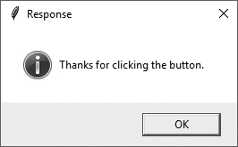
Button Widgets and Info Dialog Boxes
The main window displayed
The info dialog box displayed

Slide 34
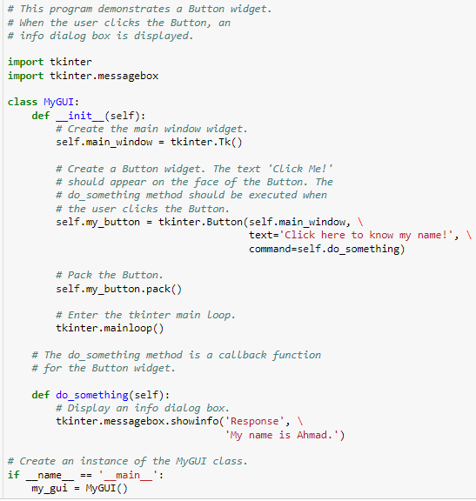

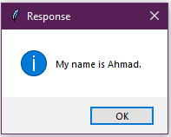
tkinter.messagebox.showinfo(title, message)

Slide 35
Creating a Quit Button
GUI programs usually have a Quit button (or an Exit button) that closes the program when the user clicks it.
To create a Quit button in a Python program, you simply create a Button widget that calls the root widget’s destroy method as a callback function.
Quit button: closes the program when the user clicks it
To create a quit button in Python:
Create a Button widget
Set the root widget’s destroy method as the callback function
When the user clicks the button the destroy method is called and the program ends

Slide 36
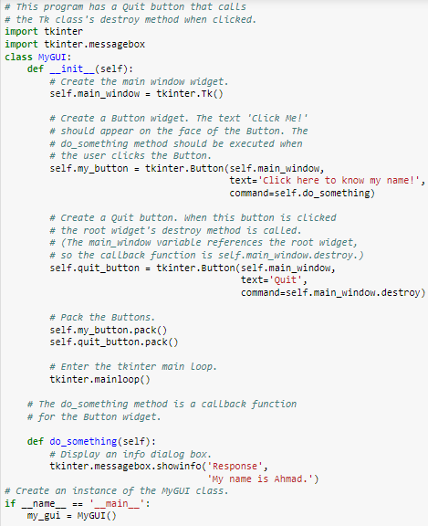

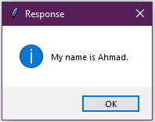
When the Quit button is clicked, the root widget's destroy method is called and the program ends

Slide 37
Getting Input with the Entry Widget
Entry widget: A rectangular area that the user can type text into.
Used to gather input in a GUI program
Typically followed by a button for submitting the data
The button’s callback function retrieves the data from the Entry widgets and processes it
Entry widget’s get method: used to retrieve the data from an Entry widget
Returns a string

Slide 38
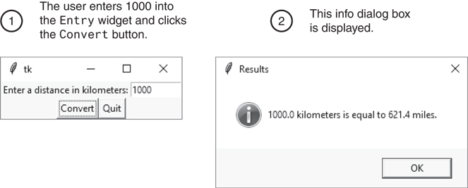
Getting Input with the Entry Widget
The info dialog box

Slide 39
Using Labels as Output Fields
Can use Label widgets to dynamically display output
Used to replace info dialog box
Create empty Label widget in main window, and write code that displays desired data in the label when a button is clicked

Slide 40
Using Labels as Output Fields
StringVar class: tkinter module class that can be used along with Label widget to display data
Create StringVar object and then create Label widget and associate it with the StringVar object
Subsequently, any value stored in the StringVar object with automatically be displayed in the Label widget

Slide 41
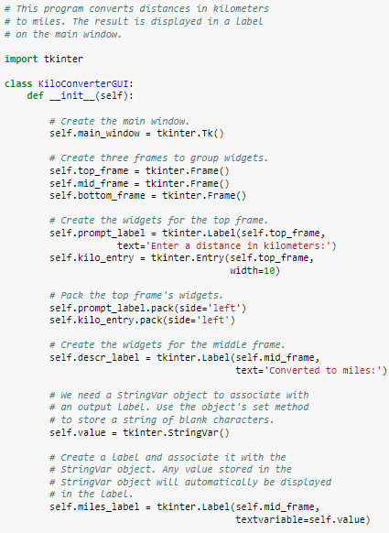
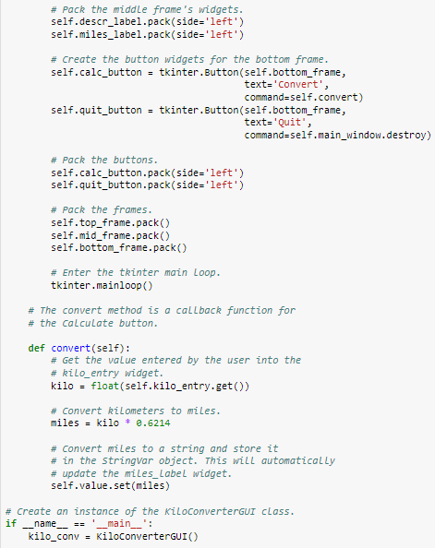
Notice that we use the argument textvariable=self.value.
This creates an association between the Label widget and the StringVar object that is referenced by the value variable.
Any value that we store in the StringVar object will be displayed in the label.

Slide 42
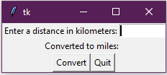
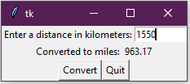
Using Labels as Output Fields
The window initially displayed
The window showing 1550 kilometers converted to miles

Slide 43
More about Tkinter pack() Method
Syntax: widget.pack( pack_options )
Here is the list of possible options:
expand − When set to true, widget expands to fill any space not otherwise used in widget's parent.
fill − Determines whether widget fills any extra space allocated to it by the packer or keeps its own minimal dimensions: NONE (default), X (fill only horizontally), Y (fill only vertically), or BOTH (fill both horizontally and vertically).
side − Determines which side of the parent widget packs against: TOP (default), BOTTOM, LEFT, or RIGHT.

Slide 44
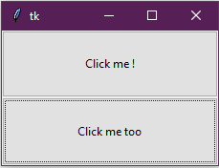
More techniques to use pack method
# Importing tkinter module
from tkinter import *
# creating Tk window
master = Tk()
# creating a Frame which can expand according
# to the size of the window
pane = Frame(master)
pane.pack(fill = BOTH, expand = True)
# button widgets which can also expand and fill
# in the parent widget entirely
# Button 1
b1 = Button(pane, text = "Click me!")
b1.pack(fill = BOTH, expand = True)
# Button 2
b2 = Button(pane, text = "Click me too")
b2.pack(fill = BOTH, expand = True)
# Execute Tkinter
master.mainloop()

Slide 45
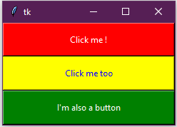
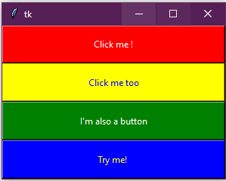
More techniques to use pack method
from tkinter import *
# creating Tk window
master = Tk()
# creating a Frame which can expand according
# to the size of the window
pane = Frame(master)
pane.pack(fill = BOTH, expand = True)
# button widgets which can also expand and fill
# in the parent widget entirely
# Button 1
b1 = Button(pane, text = "Click me !",
bg = "red", fg = "white")
b1.pack(side = TOP, expand = True, fill = BOTH)
# Button 2
b2 = Button(pane, text = "Click me too",
bg = "yellow", fg = "blue")
b2.pack(side = TOP, expand = True, fill = BOTH)
# Button 3
b3 = Button(pane, text = "I'm also a button",
bg = "green", fg = "white")
b3.pack(side = TOP, expand = True, fill = BOTH)
# Execute Tkinter
master.mainloop()
Question: what are the needed lines that we should add to have this output?

Slide 46

More techniques to use pack method
# Importing tkinter module
from tkinter import *
# from tkinter.ttk import *
# creating Tk window
master = Tk()
# creating a Fra, e which can expand according
# to the size of the window
pane = Frame(master)
pane.pack(fill = BOTH, expand = True)
# button widgets which can also expand and fill
# in the parent widget entirely
# Button 1
b1 = Button(pane, text = "Click me !",
bg = "red", fg = "white")
b1.pack(side = LEFT, expand = True, fill = BOTH)
# Button 2
b2 = Button(pane, text = "Click me too",
bg = "blue", fg = "white")
b2.pack(side = LEFT, expand = True, fill = BOTH)
# Button 3
b3 = Button(pane, text = "I'm also a button",
bg = "green", fg = "white")
b3.pack(side = LEFT, expand = True, fill = BOTH)
# Execute Tkinter
master.mainloop()

